Slide 1
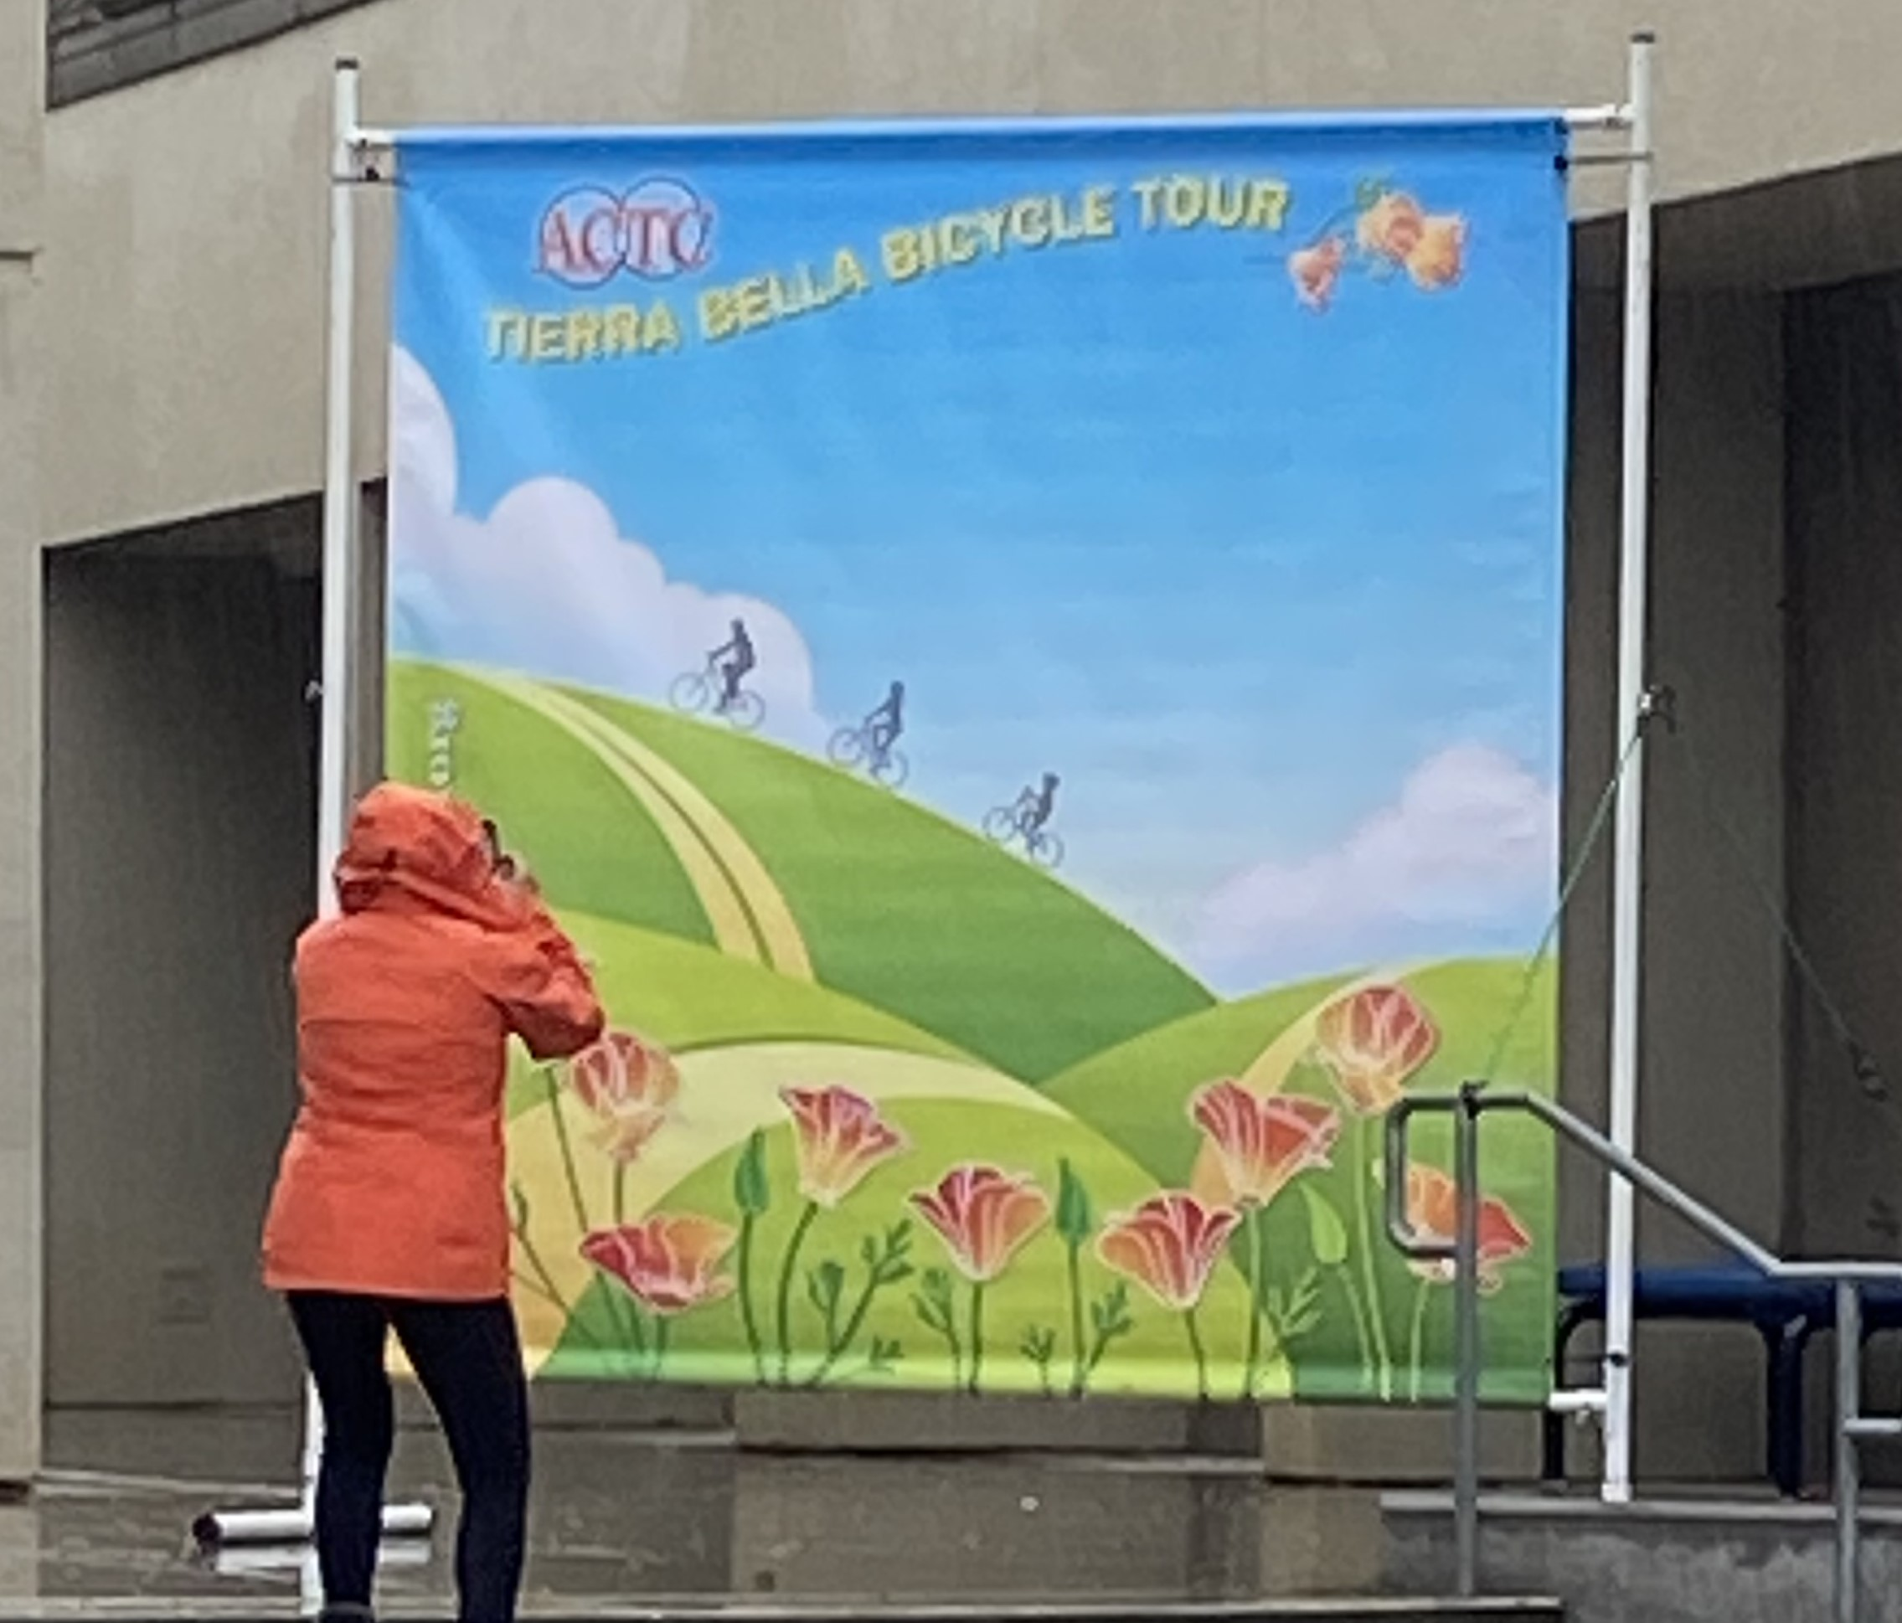
-1-
-2-
ACTC Banner Assembly
(Tools Needed)
Cordless Drill and spare Battery
( For driving Auger stakes into the ground if it is windy; In the Black Bag
with the (4) Stakes is a Socket that fits the Hex on the top of the Stakes;
After driving the Stakes into the ground, screw in the 4 Eyebolts )
** There are Eyebolts on both uprights that can be used also with Ratchet Straps
or bungee cords that can hook to Auger Stakes or a railing etc. (Straps and bungees not supplied.)
(Parts List)
ACTC Terra Bella Banner (In Cardboard Tube)
(2) 1” diameter Rods; Upper rod is 3/8” longer and labeled. (Rolled up with
Banner in Cardboard Tube.)
(2) Vertical Uprights with adjustable lower bracket with Thumbscrews
- (4) Black Bungee Ball loops (In Ammo Box)
(6) Hitch Pins (In Ammo Box)
(2) Base supports
(4) Auger Stakes & Eyebolts (In Ammo Box)
(4) Velcro Straps to tie Base support tubes to Eyebolts in stakes. (In Ammo Box)

Slide 2
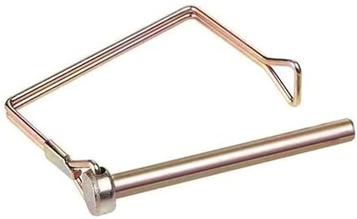
-3-
-4-
Pick Location; Lay Banner on ground and slide Upper and Lower support Rods through pockets, if not already installed; The Top Rod Is labeled & roughly 3/8” longer.
Lift one lower corner RED band, & slide one Stand Base over until the RED band is just visible; install lock Pin. Repeat for other side…
1
3
ACTC
Terra Bella
ACTC
Terra Bella
4
Install (4) Black Bungees. Pinch the free end loop and pass thru the grommet hole then pass around side post and secure loop around plastic ball. Center Banner at this stage so all bungees are stretched equally.
Vertical poles are identical. Slide side sockets over Rod Ends & install 2 hitch pins per side; make sure Thumbscrew adjustable sockets are at the bottom. Leave Thumbscrews just loose at this point.
2
ACTC
Terra Bella
ACTC
Terra Bella

Slide 3
-5-
-6-
5
Use two people to Tilt Assembly UP in final Location.
Tighten Thumb Screws finger tight pulling down gently.
Install (4) Velcro straps through ground stake Eyes and around stand legs.
7
ACTC
Terra Bella
ACTC
Terra Bella
Screw in (4) ground stakes Using Cordless Drill and included Socket 1” away from the side & 2” “in” from plastic ends of the Stand Legs.
- Screw Eye Bolts into top of ground stakes with the eye facing the legs.
6
Viewed from above
Viewed from above
ACTC
Terra Bella
2”
DONE
1”

