Slide 1
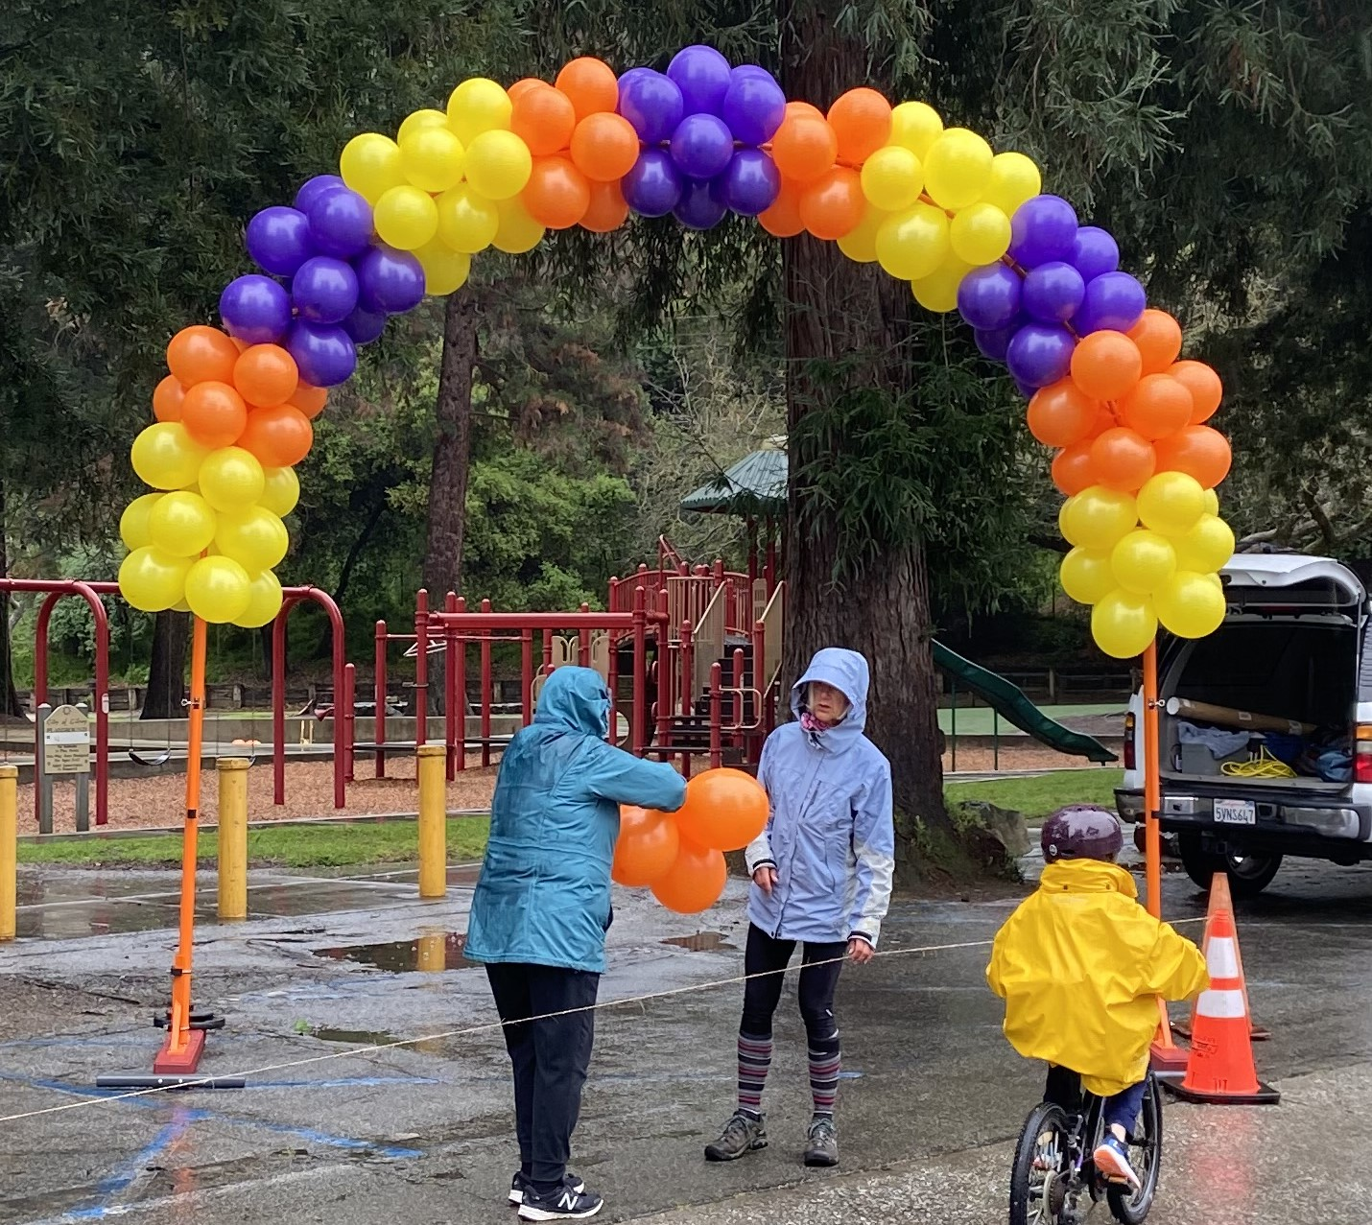
-1-
-2-
(Parts List)
(2) Wood Bases with angle iron risers and U-Bolts with nuts. ** No need to remove nuts
(2) Grey PVC stabilizer tubes to attach to the ends of wood bases (they are
temporarily stored in the U-Bolts of the Vertical uprights; Lag Bolts are screwed
Into ends of the Wood bases)
(2) 2” diameter Vertical Uprights
(1) 1” diameter ½ Arch tubing with “male” aluminum end
(1) 1” diameter ½ Arch tubing with “female” end
(2) Pound in Tubes for holding Arches during balloon Assembly (Pinned to arches)
(3) Hitch Pins (2 are holding the temporary pound in tubes to the arches; 3 more
in Ammo Box so you have 2 spares)
(3) 25# Barbell Weights; Use two on one base over plastic rod.
(2) 10# Barbell Weights; Use two on top of single 25# on other base.
ACTC “finish line” Ballon Arch

Slide 2
-3-
-4-
1
Attach stabilizer plastic tubes to Wood Bases and place them in planned Arch location.
- The U-Bolts, plastic spacer and nuts are already attached, just loosen screws with the 13mm wrench to allow the Grey Stabilizer pipes to slip out.
- Back out Lag Bolts completely, slide thru holes in tubes, and use Drill & ½” socket/adapter in “Tool Kit” to attach tubes.
- Select Banner location; Place Wood stands on ground roughly 12’ 6” apart. Orient the vertical angle iron so the “V” faces IN…and the Black plastic post faces the wind.
(Tools Needed)
Cordless Drill and spare Battery
½” Socket 3/8 drive with Drill Chuck adapter for attaching PVC pipes (In Ammo Box in a Black Bag labeled Tool kit)
13mm Open end Wrench for tightening U-Bolt nuts. (In Ammo Box)
4# Orange Harbor Freight Dead Blow Hammer for pounding Balloon
assembly pipes into the ground.
(Strapped to Wood Base)
** Do not use metal hammers; it will distort the inside diameter and the you will not be able to insert the Arch ends.
12’ 6’’
WIND
Weights will be placed on the Black
Plastic “posts” later; place them facing
the anticipated “WIND”

Slide 3
-5-
-6-
2
** Two people Required:
Install 2” diameter orange vertical posts into V’s with Black “end cap” down.
- While one person lowers the post the other can wiggle the U-Bolts so it slides thru to the base.
- Turn U-Bolt nuts by hand so the two vertical poles can be rotated to align the “Latch Pin hole” with Arch tubing hole.
3
Maintaining the 12’ 6” spacing between supports, rotate them about the grey pipe and extend the prop rod so it is vertical to the ground and supports the weight of the orange tube. You are now “done” with initial setup of the arch support structure; Balloons must be assembled on the arch sections next.
WIND
Looking down …the “prop rod” attached to the 2” vertical post should be pointing toward the grey PVC pipe end of the base. **This is also the correct orientation for the Latch Pin Hole .
- Hand tighten 4 U-Bolt Nuts after it is aligned properly.

Slide 4
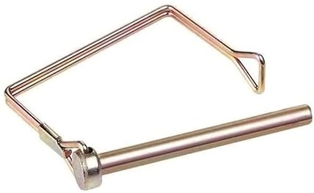
-7-
-8-
4
Select an area on the grass or dirt to slide Balloon clusters secured to plastic clips onto each halve of the arch.
Pound “ TAN “ tubes into ground with dead blow plastic hammer roughly 8” deep and approximately 8’ apart.
** One end is smoothed and polished inside to accept the Arch plastic ends and has a RED heat shrink band around the tube.
*** Orient the “hitch pin hole” as shown below:
5
** Two people Required:
Install one half of arch, plastic bushings down, into each of the TAN Pipes.
Install Hitch Pin thru TAN Pipe and Arch Plastic to stabilize the arch during balloon assembly.
*** 2nd person may need to swivel the arch section to get the pin thru.
8 feet

Slide 5
-9-
-10-
6
Slide the “4 pack” Balloons groups down the half arch segment. Put you hand between the Balloons and push around the outside of the plastic fitting, not the center. Forming a circle with your thumb and index finger works well to push them down the tubing..
7
Continue adding Balloons groups down both half arch segments until they are full.
*** Leave Hitch Pin hole exposed on orange tube.

Slide 6
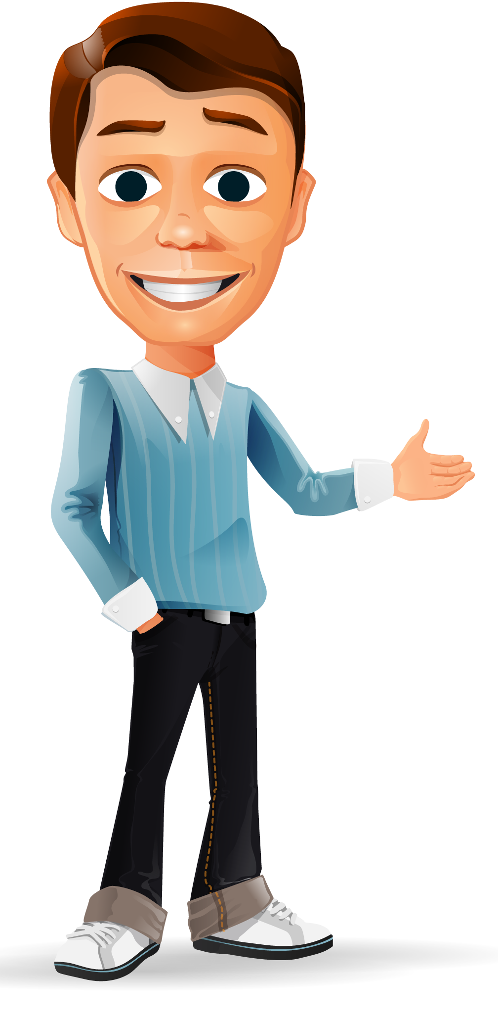
-11-
-12-
8
** Two people Required:
- Leave one Arch segment in the TAN pipe.
- Remove hitch pin on other Arch segment, remove from TAN Tube and carry over to other Arch segment. Slide polished Aluminum bushing into the other Arch tube and insert Hitch Pin.
** Three people Required:
Remove Hitch Pin from final TAN Pipe and with with one person on each end and one in the middle of the assembled Arch; carry it to the Bases which are tilted on their ends.
With 3 people positioned as shown, carefully slide the Arch legs into the orange pipes.
The center person may need to rock the arch up and down to get the ends to slide in.
Install Hitch Pins…you may have to rotate the orange pipe to get the pins thru. If this is necessary, loosen the U-Bolt nuts slightly, install hitch pin, they retighten all U-Bolt nuts wrist tight.
9
Aerial
View

Slide 7
-13-
10
** Two people required
Final Step: With one person on each end, holding the 2” orange tubes, slowly rotated the Arch to the vertical position.
Check tightness on all U-Bolt nuts one more time using the 13mm wrench.
Fold Prop Rod back against 2’ tube
Place one 25# barbell weight on both black plastic posts, then another 25# on one and the remaining 10# barbell weights on the other.
(Optional: The grey PVC pipe can be removed from the wood bases at this time IF DESIRED)
WIND

