Slide 1
New Routes Starting from Gavilan College B/W Maps
2/23/2020

Slide 2
Instructions for making Black/White Route Maps
Using Powerpoint and PAINT
Start with a google maps route of all roads to be used
Put the color map onto a slide, and resize it to fill the page
Using the line function, draw line segments for all of the roads, and any other roads to include, color = Black, width = 1
Add Hwy 101, color = grey, width = 6
Using the text function, enter and position all of the road names, fontsize = 8
Add reststop names, fontsize = 14
Once everything is positioned correctly, then group all together. This is the master slide.
Save the file
Copy the master to a new slide
Carefully select all of the text, then ctrl-X to delete them
Add a new slide, then ctrl-V to put all the text onto it.
Save all this text as a group.
On the slide that now has just roads (because text was removed), select all roads and assign to a group.
Save the file again
For each route do the following steps
Copy roads-only slide to a new slide
Select each line segment that is part of the route, then set width = 3
Go back to the text-only slide, select all, the ctrl-c to copy
Go back to the route slide, then ctrl-V to paste
Now select all on this route slide and group together.
Ctrl-C to copy, then go to PAINT, and ctrl-V to paste. Save as a JPG file.

Slide 3
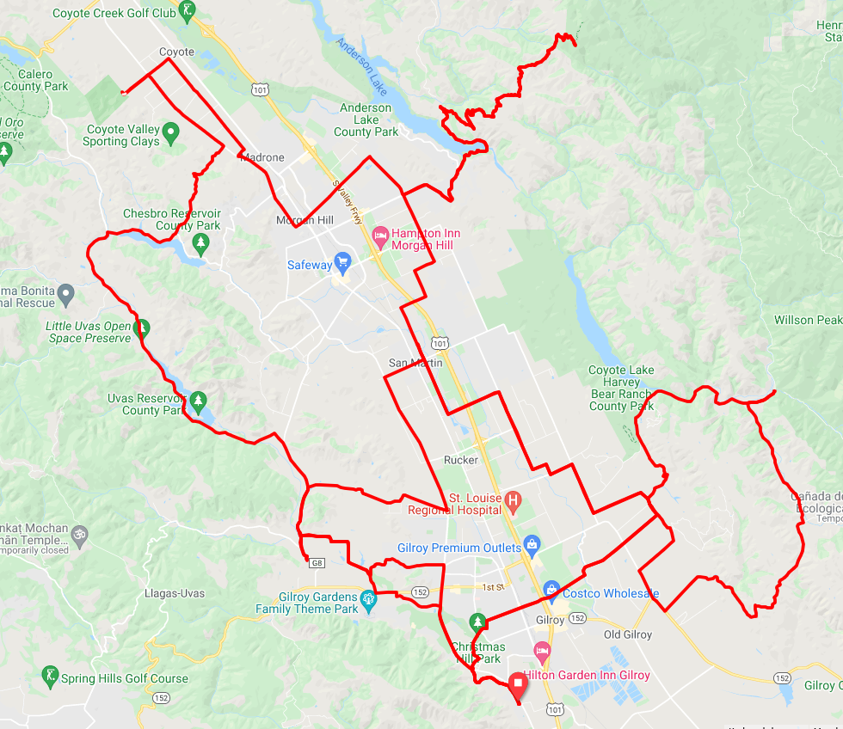
Henry Coe
Coyote Valley OSP at Palm Ave
San Martin
Hunting Hollow
Chitactac-Adams County Park
GavilanCollege

Slide 4
Palm
Henry Coe
Coyote Valley
Coyote Valley OSP at Palm Ave
Henry Coe
Dougherty
Hale
Monterey Hwy
Tilton
Uvas Rd
Hill
Willow Springs
Main
Dunne
Llagas
Hale
Oak Glen
Chesbro Reservoir
Tennent
Hill
Maple
Uvas Rd
Sycamore
Middle
San Martin
San Martin
Hunting Hollow
San Martin
Hunting Hollow
Watsonville
Santa Teresa
Llagas
Uvas Reservoir
Monterey Rd
Church
Gilroy Hot Springs
Center
Roop
Uvas Rd
Canada
Omar
Roop
Buena Vista
Leavesley
Watsonville
Day
Foothill
New
Dryden
Chitactac-Adams County Park
Leavesley
Crews
Burchell
Leavesley
Godfrey
Chictactac Adams
Country
Santa Teresa
Dunlap
Bluebell
Mantelli
Crews
Burchell
First
Gilman
Ferguson
Canada
Hecker Pass Hwy
Sixth
Holsclaw
Third
Miller
Monterey Rd
Pacheco Pass Hwy
Santa Teresa
Pacheco Pass Hwy
Gavilan College
Miller
GavilanCollege
Mesa

Slide 6
Palm
Coyote Valley
Henry Coe
Dougherty
Hale
Monterey Hwy
Tilton
Uvas Rd
Hill
Willow Springs
Main
Dunne
Llagas
Hale
Oak Glen
Chesbro Reservoir
Tennent
Hill
Maple
Uvas Rd
Sycamore
Middle
San Martin
Hunting Hollow
San Martin
Watsonville
Santa Teresa
Llagas
Uvas Reservoir
Monterey Rd
Church
Gilroy Hot Springs
Center
Roop
Uvas Rd
Canada
Omar
Roop
Buena Vista
Leavesley
Watsonville
Day
Foothill
New
Dryden
Leavesley
Crews
Burchell
Leavesley
Godfrey
Chictactac Adams
Country
Santa Teresa
Dunlap
Bluebell
Mantelli
Crews
Burchell
First
Gilman
Ferguson
Canada
Hecker Pass Hwy
Sixth
Holsclaw
Third
Miller
Monterey Rd
Pacheco Pass Hwy
Santa Teresa
Pacheco Pass Hwy
Gavilan College
Miller
Mesa

Slide 7
Palm
Coyote Valley
Henry Coe
Dougherty
Hale
Monterey Hwy
Tilton
Uvas Rd
Hill
Willow Springs
Main
Dunne
33-Mile Route
Yellow Arrows
Llagas
Hale
Oak Glen
Chesbro Reservoir
Tennent
Hill
Maple
Uvas Rd
Sycamore
Middle
San Martin
Hunting Hollow
San Martin
Watsonville
Santa Teresa
Llagas
Uvas Reservoir
Monterey Rd
Church
Gilroy Hot Springs
Center
Roop
Uvas Rd
Canada
Omar
Roop
Buena Vista
Leavesley
Watsonville
Day
Foothill
New
Dryden
Leavesley
Crews
Burchell
Leavesley
Godfrey
Chictactac Adams
Country
Santa Teresa
Dunlap
Bluebell
Mantelli
Crews
Burchell
First
Gilman
Ferguson
Canada
Hecker Pass Hwy
Sixth
Holsclaw
Third
Miller
Monterey Rd
Pacheco Pass Hwy
Santa Teresa
Pacheco Pass Hwy
Gavilan College
Miller
Mesa

Slide 8
Palm
Coyote Valley
Henry Coe
Dougherty
Hale
Monterey Hwy
Tilton
Uvas Rd
Willow Springs
Main
Hill
100K Route
Green Arrows
Llagas
Hale
Dunne
Oak Glen
Chesbro Reservoir
Tennent
Hill
Maple
Uvas Rd
Sycamore
Middle
San Martin
Hunting Hollow
San Martin
Watsonville
Santa Teresa
Llagas
Uvas Reservoir
Monterey Rd
Church
Gilroy Hot Springs
Center
Roop
Uvas Rd
Canada
Omar
Roop
Buena Vista
Leavesley
Watsonville
Day
Foothill
New
Dryden
Leavesley
Crews
Burchell
Leavesley
Godfrey
Chictactac Adams
Country
Santa Teresa
Dunlap
Bluebell
Mantelli
Crews
Burchell
First
Gilman
Ferguson
Canada
Hecker Pass Hwy
Sixth
Holsclaw
Third
Miller
Monterey Rd
Pacheco Pass Hwy
Santa Teresa
Pacheco Pass Hwy
Gavilan College
Miller
Mesa

Slide 9
Palm
Coyote Valley
Henry Coe
Dougherty
Hale
Monterey Hwy
Tilton
Uvas Rd
Hill
Willow Springs
Main
Dunne
Hilly 100K Route
Blue Arrows
Llagas
Hale
Oak Glen
Long option
Green Arrows
Tennent
Hill
Chesbro Reservoir
Maple
Uvas Rd
Sycamore
Middle
San Martin
Hunting Hollow
San Martin
Watsonville
Santa Teresa
Llagas
Uvas Reservoir
Monterey Rd
Church
Gilroy Hot Springs
Short option
Blue Arrows
Center
Roop
Uvas Rd
Canada
Omar
Roop
Buena Vista
Leavesley
Watsonville
Day
Foothill
New
Dryden
Leavesley
Crews
Burchell
Leavesley
Godfrey
Chictactac Adams
Country
Santa Teresa
Dunlap
Bluebell
Mantelli
Crews
Burchell
First
Gilman
Ferguson
Canada
Hecker Pass Hwy
Sixth
Holsclaw
Third
Miller
Monterey Rd
Pacheco Pass Hwy
Santa Teresa
Pacheco Pass Hwy
Gavilan College
Miller
Mesa

Slide 10
Palm
Coyote Valley
Henry Coe
Dougherty
Hale
Monterey Hwy
Tilton
Uvas Rd
Hill
Willow Springs
Main
Dunne
Very Hilly 100K Route
Pink Arrows
Llagas
Hale
Oak Glen
Chesbro Reservoir
Tennent
Hill
Maple
Uvas Rd
Sycamore
Middle
San Martin
Hunting Hollow
San Martin
Watsonville
Santa Teresa
Llagas
Uvas Reservoir
Monterey Rd
Church
Gilroy Hot Springs
Center
Roop
Uvas Rd
Canada
Omar
Roop
Buena Vista
Leavesley
Watsonville
Day
Foothill
New
Dryden
Leavesley
Crews
Burchell
Leavesley
Godfrey
Chictactac Adams
Country
Santa Teresa
Dunlap
Bluebell
Mantelli
Crews
Burchell
First
Gilman
Ferguson
Canada
Hecker Pass Hwy
Sixth
Holsclaw
Third
Miller
Monterey Rd
Pacheco Pass Hwy
Santa Teresa
Pacheco Pass Hwy
Gavilan College
Miller
Mesa

Slide 11
Palm
Coyote Valley
Henry Coe
Dougherty
Hale
Monterey Hwy
Tilton
Uvas Rd
Hill
Willow Springs
Main
Dunne
100-Mile Route
Orange Arrows
Llagas
Hale
Oak Glen
Chesbro Reservoir
Tennent
Hill
Maple
Uvas Rd
Sycamore
Middle
San Martin
Hunting Hollow
San Martin
Watsonville
Santa Teresa
Llagas
Uvas Reservoir
Monterey Rd
Church
Gilroy Hot Springs
Center
Roop
Uvas Rd
Canada
Omar
Roop
Buena Vista
Leavesley
Watsonville
Day
Foothill
New
Dryden
Leavesley
Crews
Burchell
Leavesley
Godfrey
Chictactac Adams
Country
Santa Teresa
Dunlap
Bluebell
Mantelli
Crews
Burchell
First
Gilman
Ferguson
Canada
Hecker Pass Hwy
Sixth
Holsclaw
Third
Miller
Monterey Rd
Pacheco Pass Hwy
Santa Teresa
Pacheco Pass Hwy
Gavilan College
Miller
Mesa

Slide 12
Palm
Coyote Valley
Henry Coe
Dougherty
Hale
Monterey Hwy
Tilton
Uvas Rd
Hill
Willow Springs
Main
Dunne
Tierra Bella 2022
All Roads
Llagas
Hale
Oak Glen
Chesbro Reservoir
Tennent
Hill
Maple
Uvas Rd
Sycamore
Middle
San Martin
Hunting Hollow
San Martin
Watsonville
Santa Teresa
Llagas
Uvas Reservoir
Monterey Rd
Church
Gilroy Hot Springs
Center
Roop
Uvas Rd
Canada
Omar
Roop
Buena Vista
Leavesley
Watsonville
Day
Foothill
New
Dryden
Leavesley
Crews
Burchell
Leavesley
Godfrey
Chictactac Adams
Country
Santa Teresa
Dunlap
Bluebell
Mantelli
Crews
Burchell
First
Gilman
Ferguson
Canada
Hecker Pass Hwy
Sixth
Holsclaw
Third
Miller
Monterey Rd
Pacheco Pass Hwy
Santa Teresa
Pacheco Pass Hwy
Gavilan College
Miller
Mesa

