Slide 1
Instructions for Estimating Riders versus Time
Using RideWithGPS, Ride-Time_Calculator, Excel, and Powerpoint
Use RideWithGPS to come up with a route, or set of routes
Select points along the route where you want to know the time that riders will be there, such as at reststops
In Excel, create a table of these checkpoints along the route, as shown below
Query RideWithGPS to get total distance and climbing from the start to each checkpoint
Enter the total miles and climbing into the table, for each checkpoint
Excel will calculate section miles and climbing

Slide 2
Instructions for Estimating Riders versus Time
Select a pace range for each route. ACTC paces are
  B (brisk)
  MB (moderate brisk)
  M (moderate)
  LM (leisurely moderate)
  L (leisurely)
Select a riding factor . Riding factor is riding time divided by total time
  90% (very short rest stops )
  70% (average rest stops)
  60% (long rest stops)
Use the ride-time-calculator to get total time for each of the selected pace and riding factor combinations.
Select a start time for each route

Slide 3
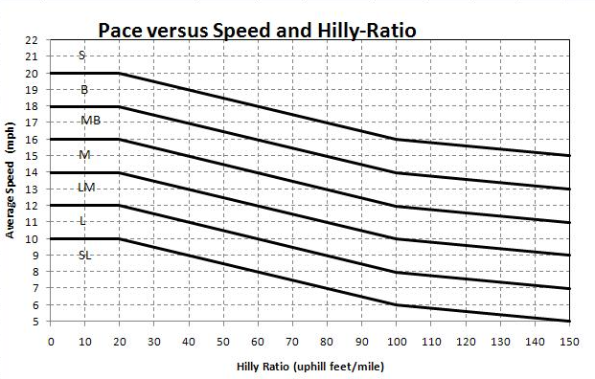
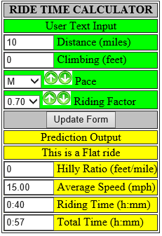
Instructions for using the Ride Time Calculator
The calculator is found here:
  https://www.actc.org/ridestats/pace/ride-time-calc.php
Enter the distance and climbing to get to each reststop (from the start)
Select a pace and a riding factor
The calculator first gets hilly-ratio, then finds the average speed from the graph
With speed, it can calculate riding time, and then total time
Write down the Total time
https://www.actc.org/ridestats/pace/ride-time-calc.php

Slide 4
Instructions for Estimating Riders versus Time
For each route, create a column for a Fast rider and a Slow Rider, using the Pace/Factor combination from the last table
Use the ride-time-calculator to get total time for each checkpoint for both Fast and Slow
Assume the Fast rider starts at the earliest time, and the Slow rider starts at the latest time
Fill in First and Last times for each checkpoint

Slide 5
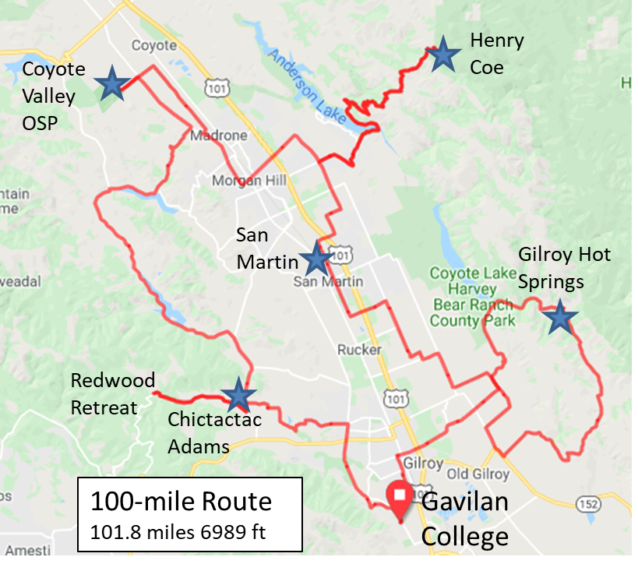
Instructions for Estimating Riders versus Time
For each route, use the First and Last times at each checkpoint to estimate where the first and last rider would be at each hour of the day, as shown below.
  Do for 8AM, 9AM, 10AM, 11AM, 12noon, 1PM, 2PM, 3PM, and 4PM
On a map of all roads, for each hour, put colored arrows along the route between First and Last rider
11:49 to 2:11
2PM
1PM
11AM
10:37 to 12:42
12noon
10AM
12noon
11AM
7:56 to 9:12
3PM
9:11 to 10:47
9AM
8AM
9AM
1PM
12:54 to 3:34
10AM
first
last
4PM
8AM
1:52 to 4:47
7:00 to 8:00
2PM

Slide 6
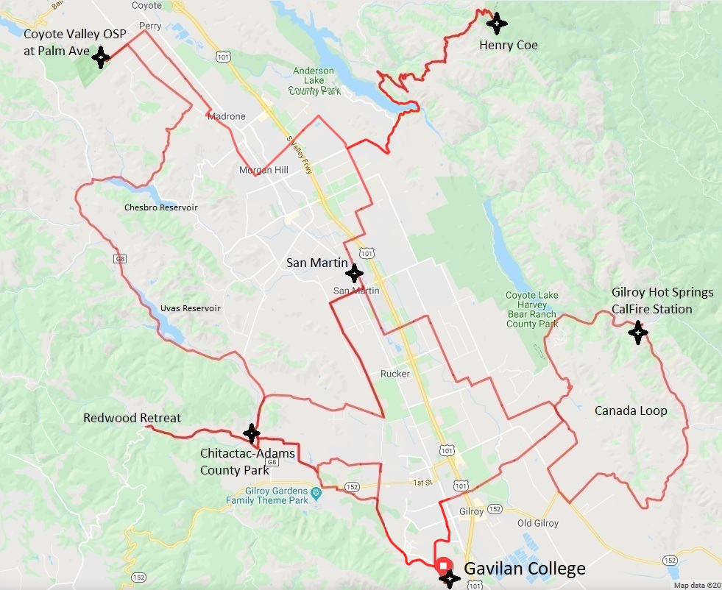
12:00 noon
100 Mile – all options
Very Hilly 100K – Henry Coe
Hilly 100K – Gilroy Hot Springs
100K- Coyote Valley OSP
33 Mile – short route

Slide 7
Instructions for Estimating Riders versus Time
For each rest stop, use the First and Last times at each route to draw a colored bar along a time line, as shown below. Each cell is a half hour.
San Martin
Chictactac Adams

Slide 8
Instructions for Estimating Riders versus Time
Assume a bell-curve distribution of riders, where the total adds up to 1.000
Count the number of half-hour cells, then use that to determine the riders for each half hour
Use registration data to get percentage of riders for each route, then scale up to get total riders

Slide 9
Instructions for Estimating Riders versus Time
Multiply number of riders for each route by the percentage for each half hour
San Martin
Chictactac Adams

Slide 10
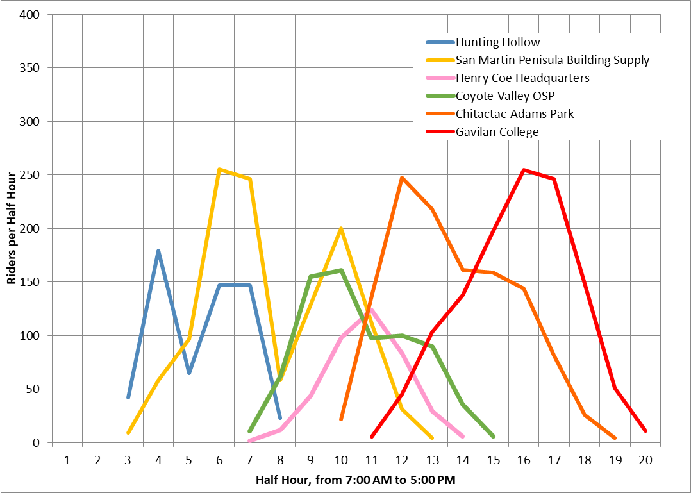
Instructions for Estimating Riders versus Time
Plot total riders per half hour for each rest stop, together on one plot

